Slide 1
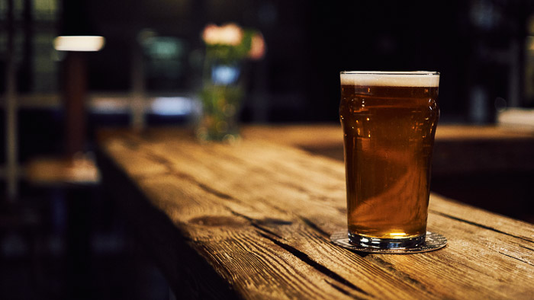
IRi: Beer Market Analysis
Group C

Slide 2
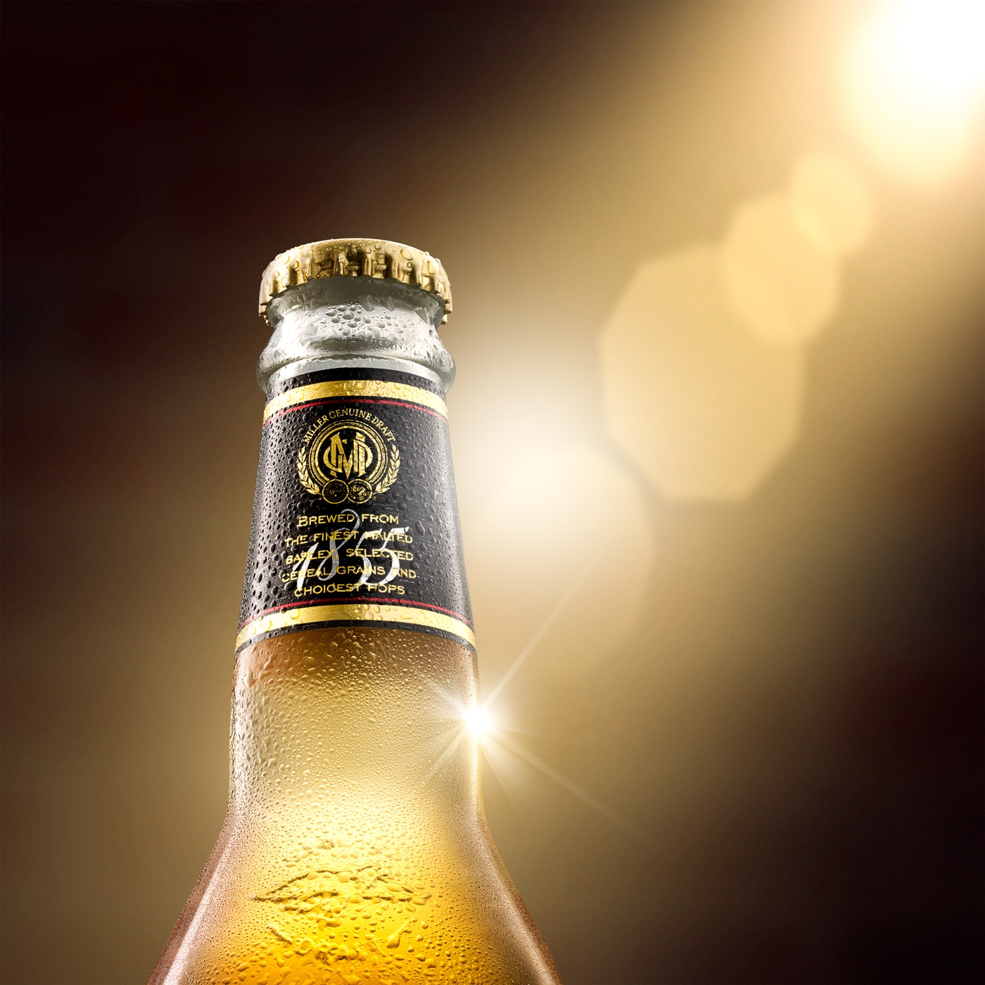
Agenda Style
01
Market Overview
General overview of the beer industry
02
Manufacturer 2
Position in the market
03
Segmentation
Current and Recommended segmentation
04
Forecast
Forecasting and recommendations

Slide 3
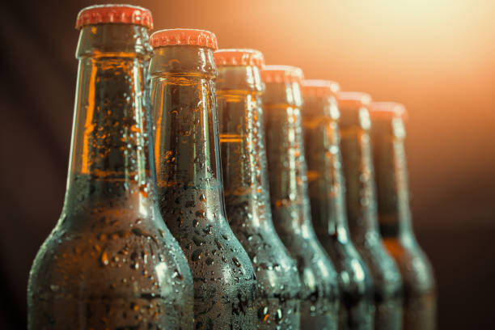
1-Market Overview

Slide 4
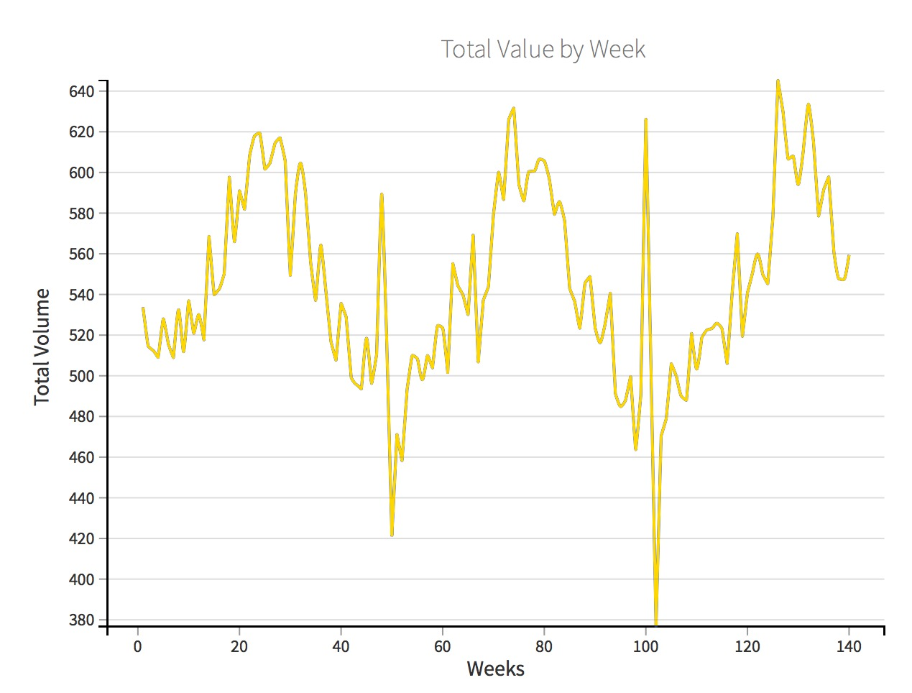
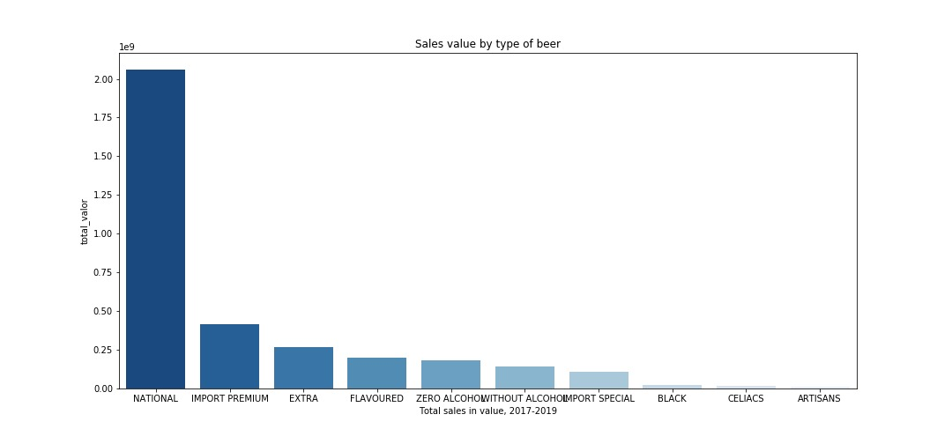
1.1 The Market View
The Overall Sales view
Seasonality in terms of the volume sold when looking at the overall trend
National beer leading the sales
Followed by Import Premium
Notes:
General Overview of the market in regards to overall sales by volume over the datasets weeks – purpose is to see when the overall market is profiting the most.
We then look at the sales by value for each type of beer separately to see which beers are the strongest in the market.

Slide 5
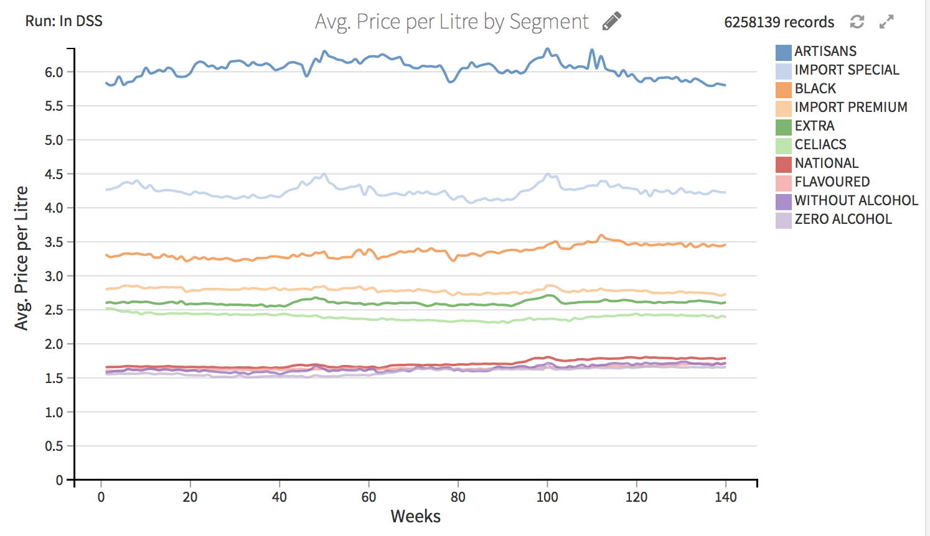
1.2 The Market View
Price per Segment
Price fluctuations per season for each segment
Seasonal price fluctuations for some segments
Notes:
A study of the market as a whole – Graphing the price fluctuations over time in order to see if there are any seasonal changes worth noticing. Seems like in the summer it is the case for some of our brands such as Extra, Import Premium, Black and Import Special.

Slide 6
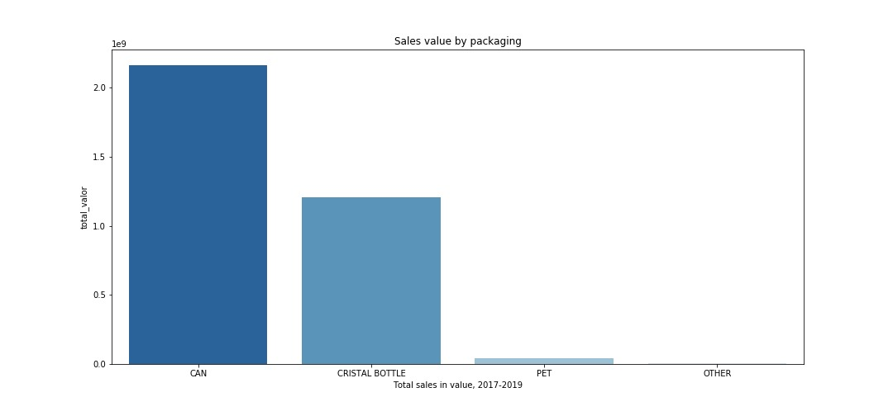
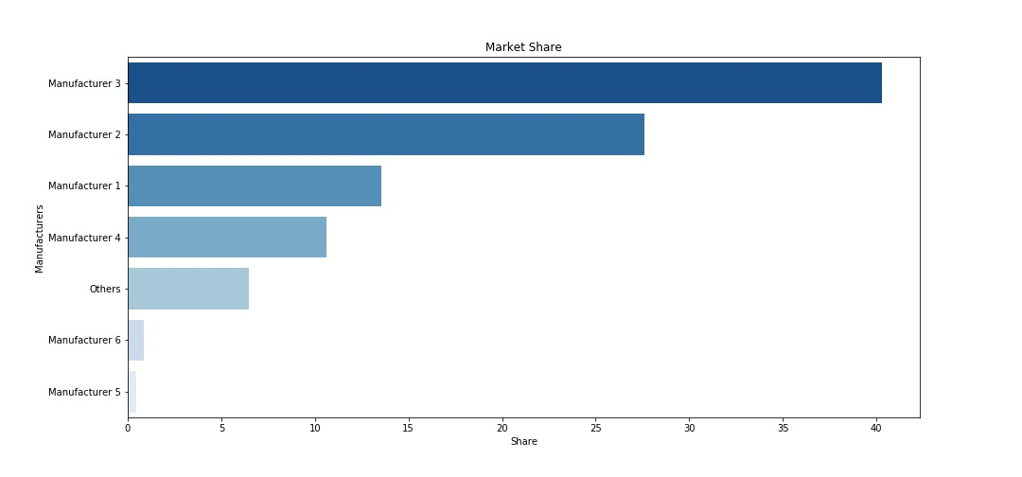
1.3 The Market View
Market Dynamics
Clear market leader: Manufacturer 3
Owning 40.31% of the total market.
Cans are preferred
Lighter in weight
Portable
Notes:
Diving in deeper to see how the different types of packaging affect sales
And a quick overlook into market share of the market to see who are the leading manufactures- THIS leads us to the next part due to the fact that it is evident that Man.3 is the leader.

Slide 7
2-Manufacturer Two
Vs. The Market

Slide 8
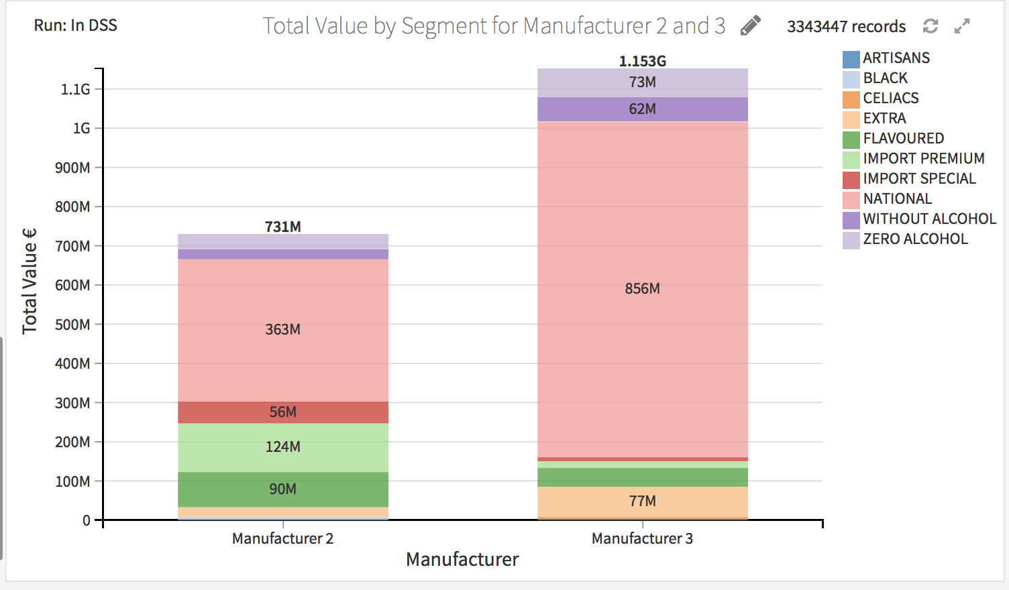
2.1 Competing
Market Dynamics
Strengths (2)
Import Premium
Import Special
Flavored
Strengths (3)
National
Sin
Zero
Extra
Notes:
Looking at our manuf. And our top competitor (and only competitor) Man3.
Comparing the segments vs total sales value in € -- we see here that we have strengths in the 2 Imports and Flavoured beer while Man3 is leading with the National by a longslide, as well as sin, zero and extra.

Slide 9
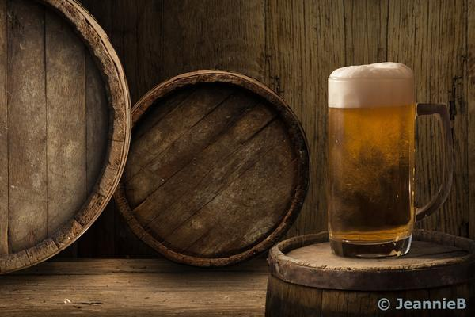

2.2- Strategies
Winning the Market
Maximizing value, volume and sales
Reduce prices to encourage demand for lagging segments:
Sin Alcohol, Zero and Black
Provide more promotions
on lower volume bottles
Focus on the dominating areas in south region:
Alicante, Cadiz and Badajoz.
Notes:
YOU CAN PICK BETWEEN THIS AND THE NEXT SLIDE THEY ARE THE SAME INFO JUST DIF. LAYOUT.

Slide 10
2.2-Strategies
Maximize Sales and Volume
Reduce prices to encourage demand for lagging segments:
Sin Alcohol, Zero and Black
Provide more promotions
on lower volume bottles
Focus on the dominating areas in south region:
Alicante, Cadiz and Badajoz.
Notes:
We therefore need to study our strategy and tweak it up to ensure to use the resources we have as best as possible.
In terms of price: Reduce prices of those segments that we are NOT leading in such as Sin, Zero and Black that Man 3 is beating us in, in order to get competitive advantage (At the moment we are charging almost twice as much as they are)
In terms of Packaging: we should provide promotions on bottled beers in smaller volumes due to the fact that smaller volumes sell more. and we are not using out power in the glass bottles.
You will see a graph for this in the next slide
As for Location: we have advantage in the south. Focus there.

Slide 11
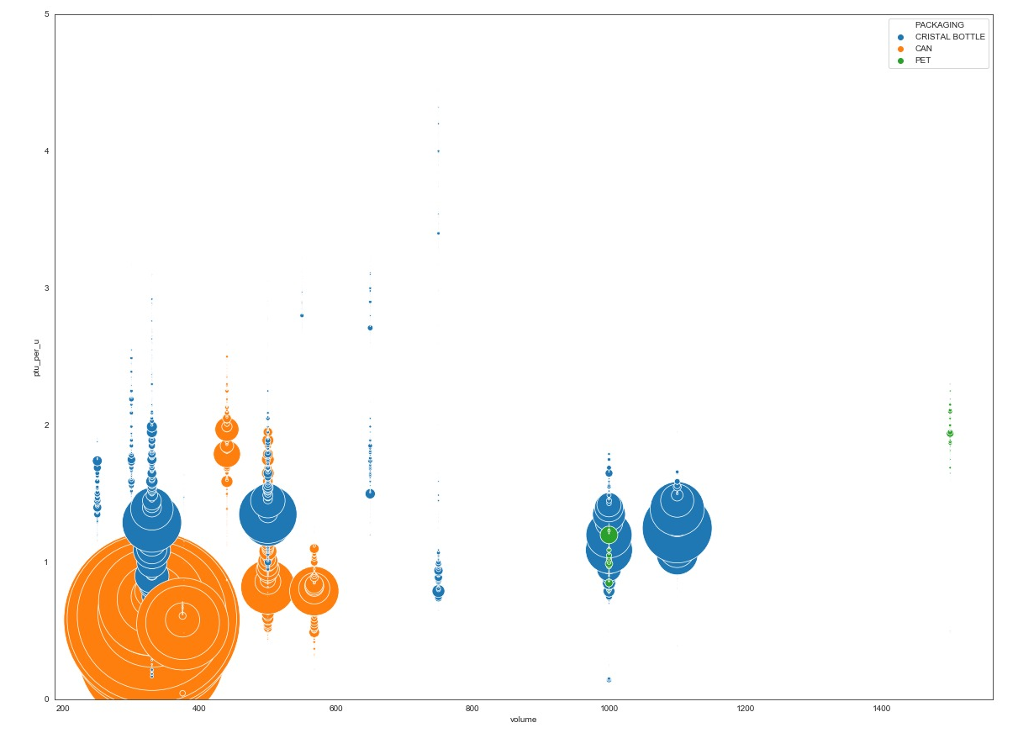
2.3 Packaging
Notes:
Talk a it more or delete this if not necessary.

Slide 12
3 -Segmentation

Slide 13
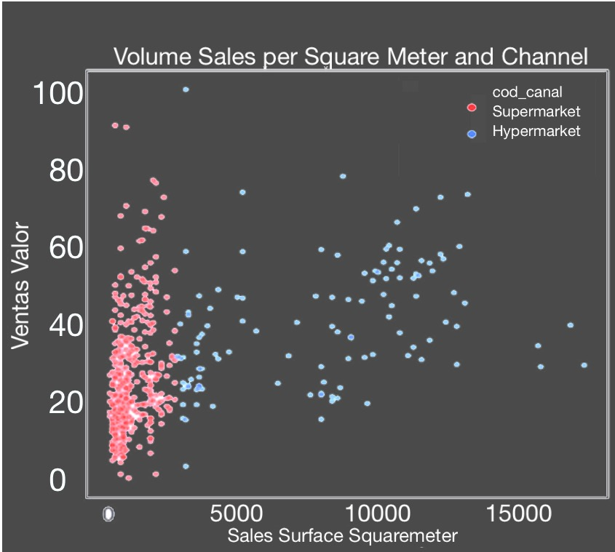
3.1-Current segmentation
Strengths
Weaknesses
Equally sized clusters
Intuitive logistics
Effective
So widespread that doesn’t give a competitive advantage
Does not take into account seasonality, segments, packaging, number of promotions
Channel | Sales in Volume | Sales in Value | Sales in Units
Hypermarket | 31.4 | 45.9 | 35.8
Supermarket | 21.7 | 29.0 | 29.4

Slide 14




3.2-Our Segmentation
Usual Suspects
Winter wonderland
Summer hotspots
Big Box
Hipster’s hangout

Slide 15
3.3-Our Segmentation
Price
Promotions
Type of beer
Total Value
Total Volume
Total Units
Price/Vol
Ordinary local stores that sell a lot of beer in cans
6.3
5.3
8.3
1.24
Usual
suspects
Flavored/
National/
Zero Alc
Winter wonderland
Stores that sell beer only in winter
0.2
0.2
0.3
1.04
Extra
Summer hotspots
Stores that sell beer only in summer
Flavored/
National
0.6
0.5
0.8
1.32
Wholesale stores that sell in PET
Zero Alc/
Flavored
25.2
19.9
15.7
Big Box
1.28
Higher price point stores that specialize in rare segments: Artisan, Celiac and Import Premium beers
Hipster’s hangout
Artisan/
Celiacs/
Import
Premium
4.8
3.2
3.9
1.53

Slide 16
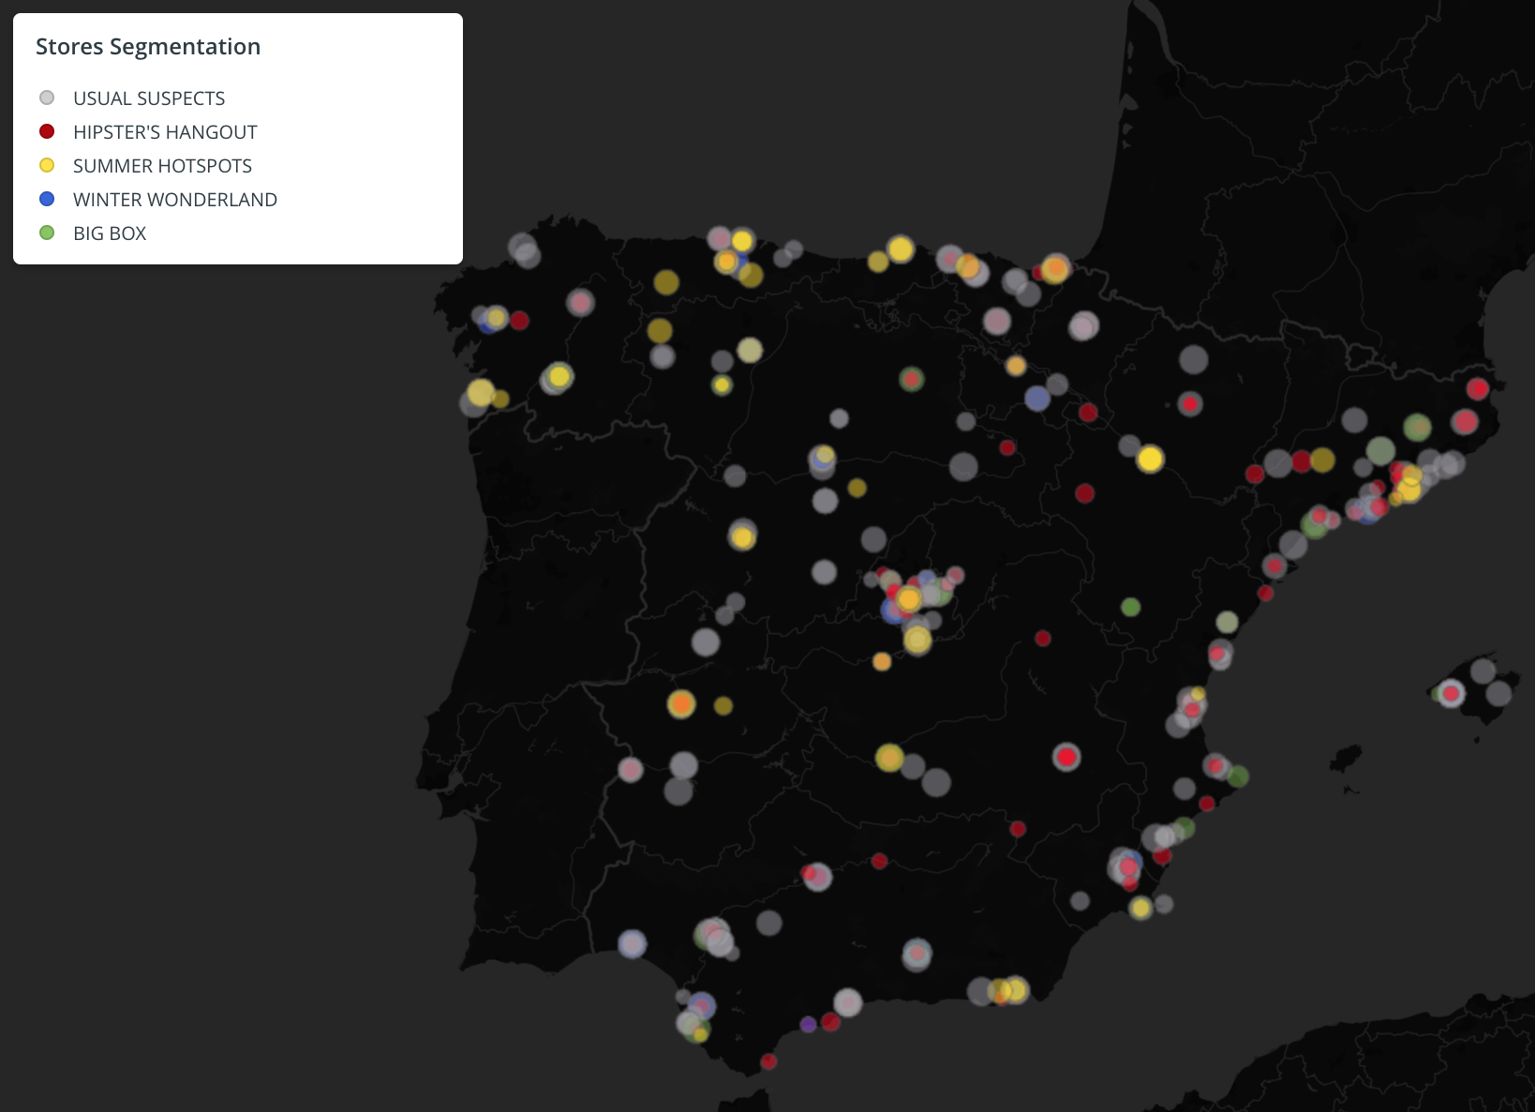
3.4- Clustering and segmenting

Slide 17
4- A View to the Future
The morning after the party

Slide 18
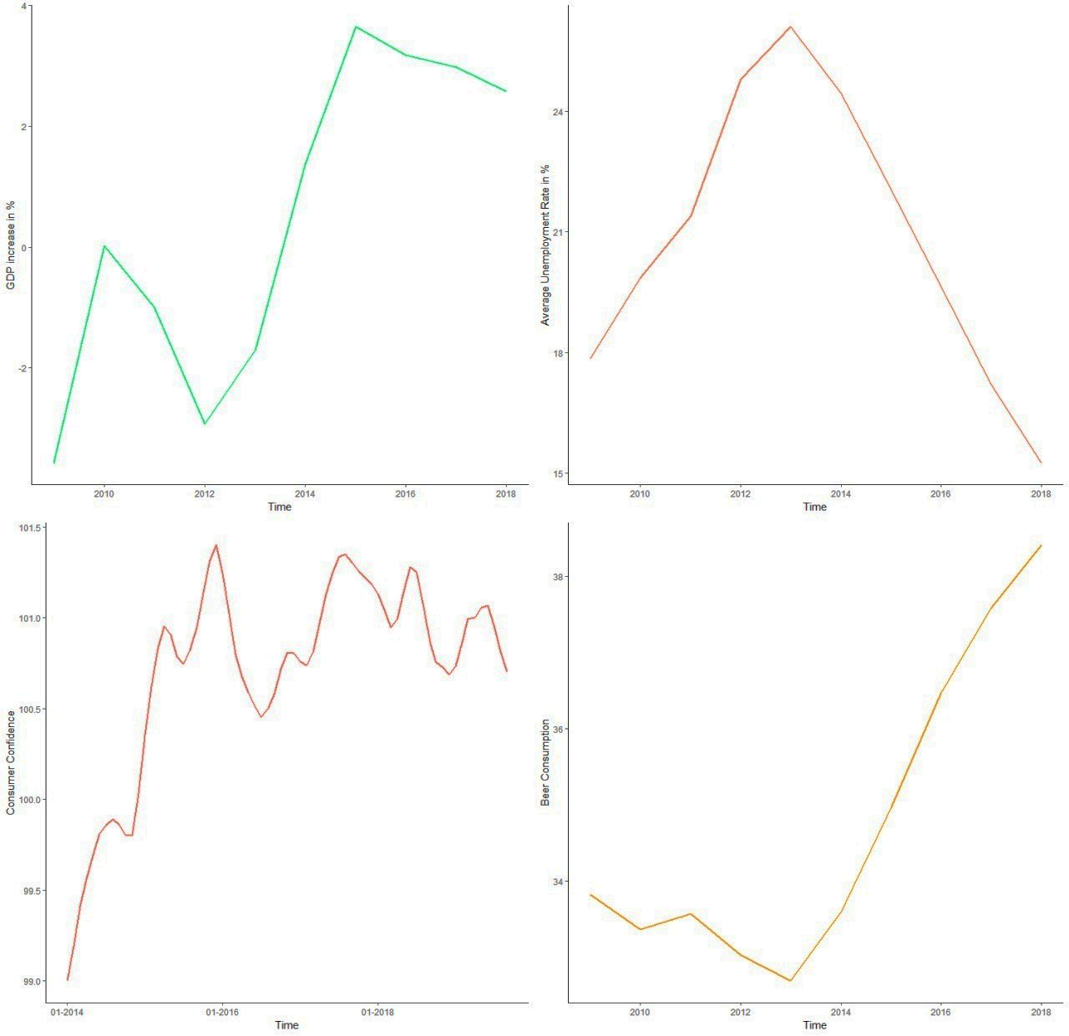
4.1-Spain’s Economy
Teetering on the edge?
GDP growth
Unemployment
Growth falling away
Consumer confidence at its lowest since x
Unemployment on the turn?
************
25% of beer consumed by foreigners
22.5% of tourists from UK
BREXIT WARNING!
CCI
Beer consumption

Slide 19
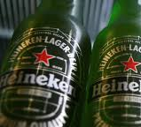
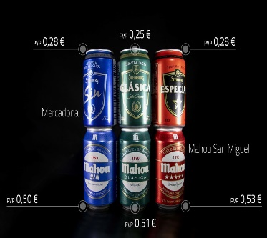
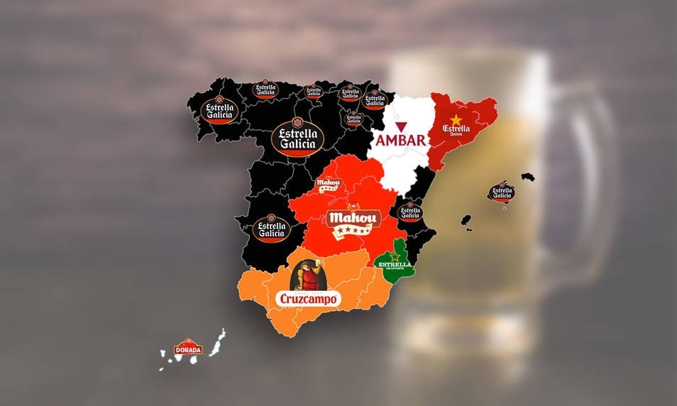
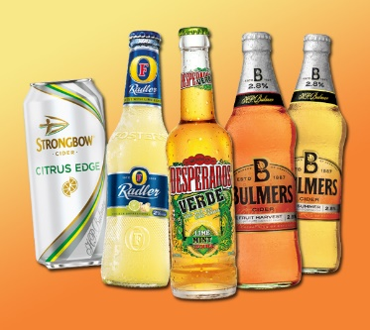
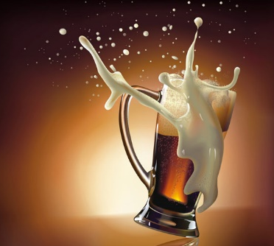
4.2-Market Factors
A rowdy crowd
Strong position
Supermarket attack
Regional preference
Seasonality
Market
Downturn
Dutch Efficiency?
Mercadona Threat
Southern Powerhouse
Flavoured summers
Disruptions Ahead

Slide 20
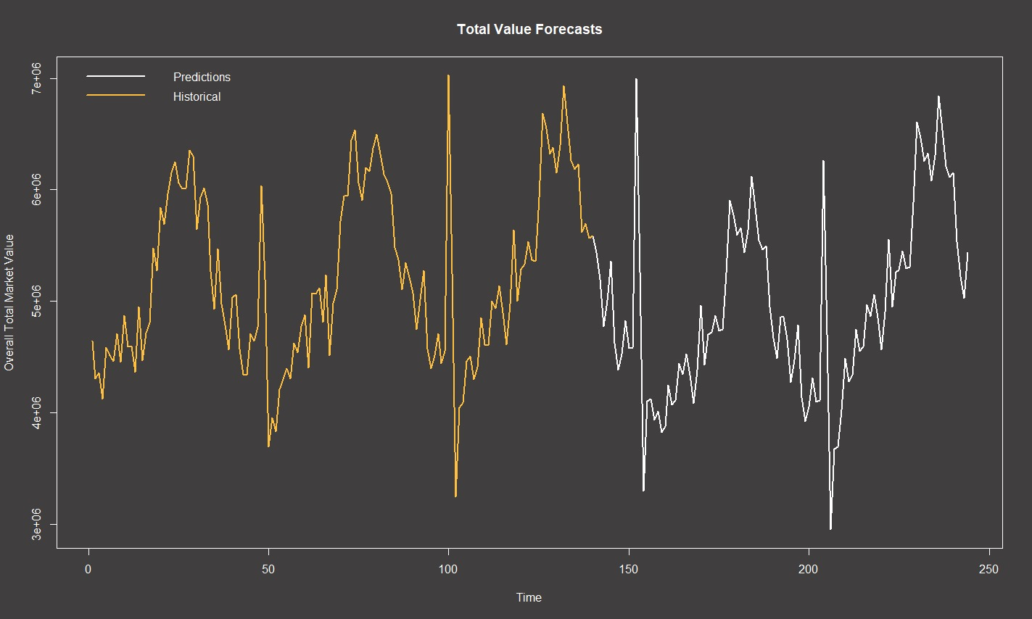
4.3-Beers into the Future

Slide 21
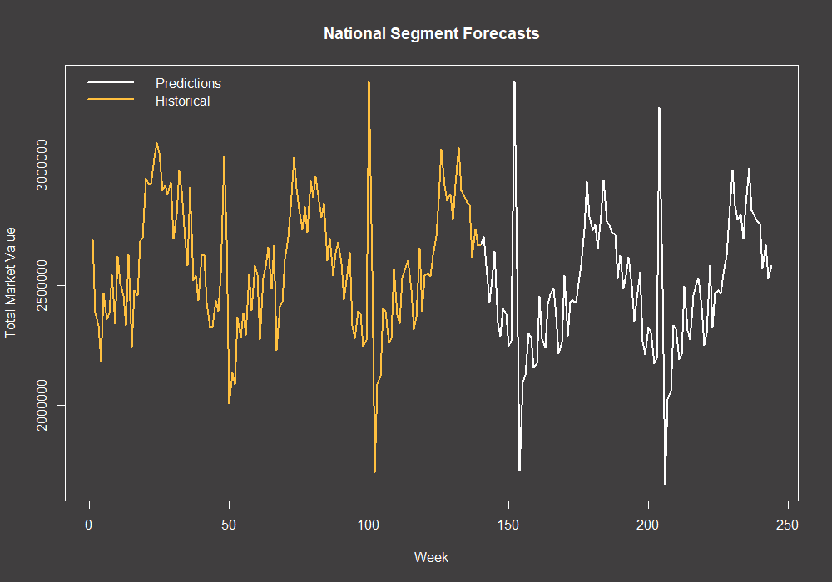
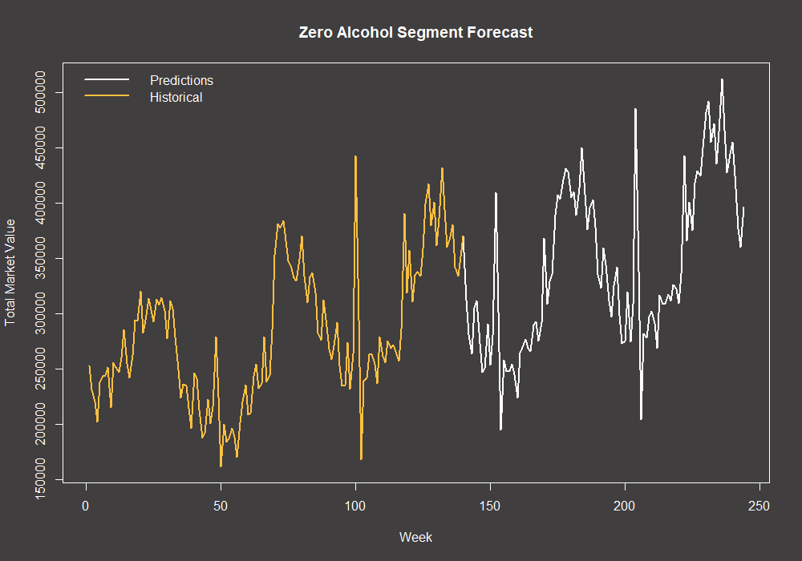
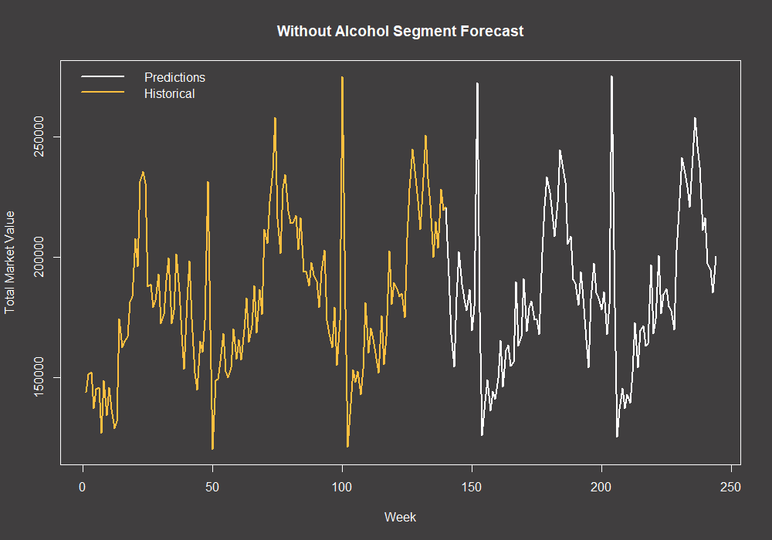
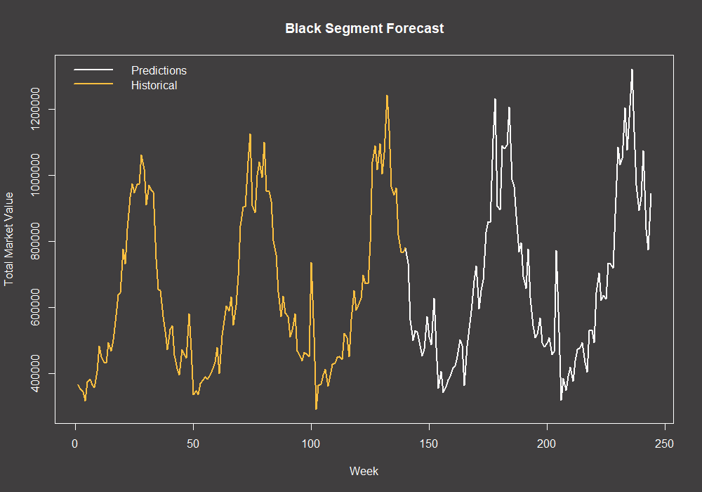
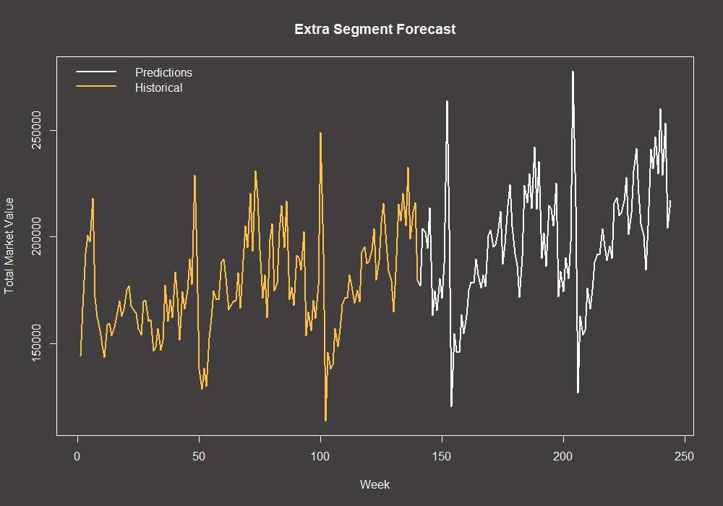
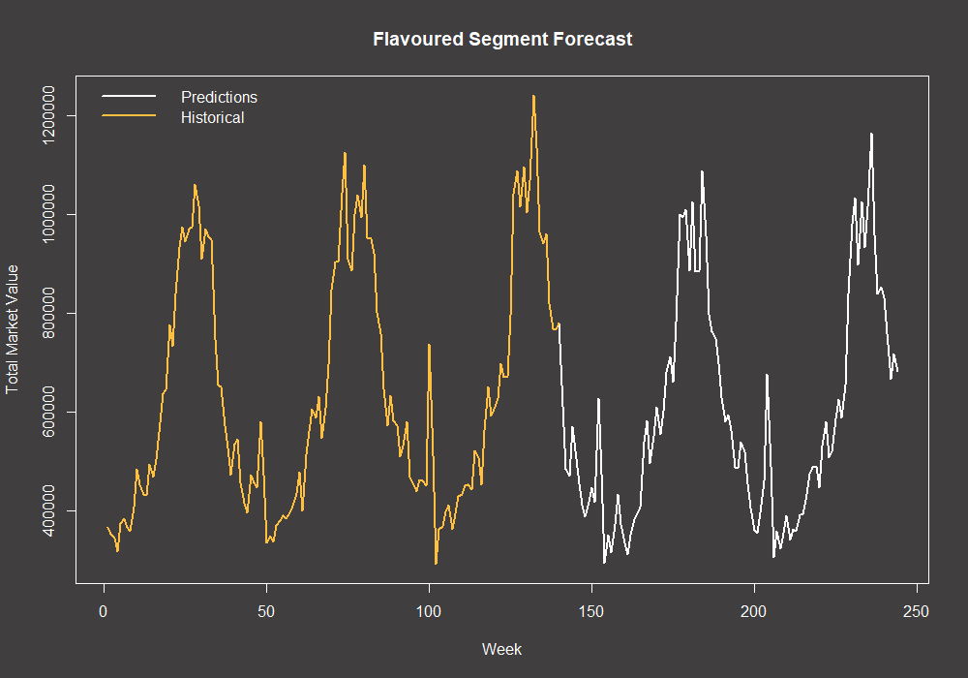
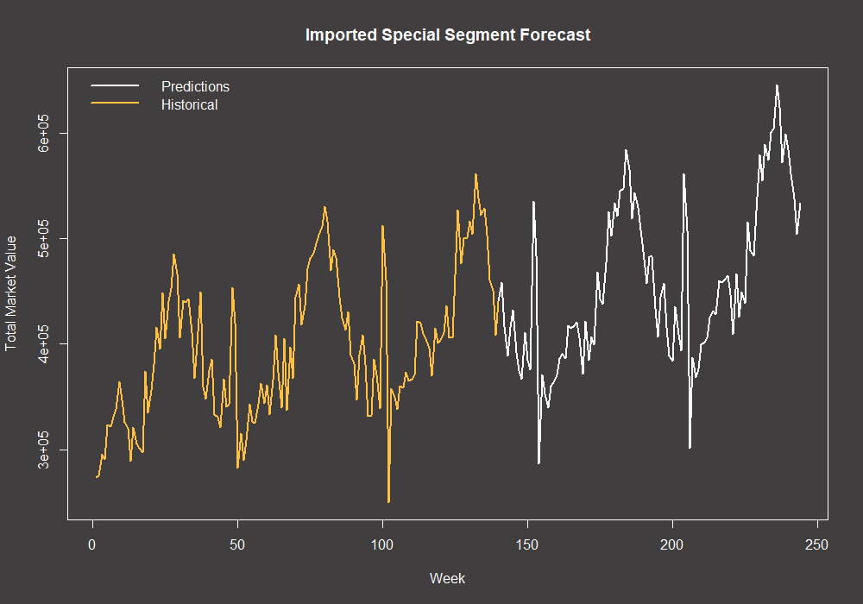
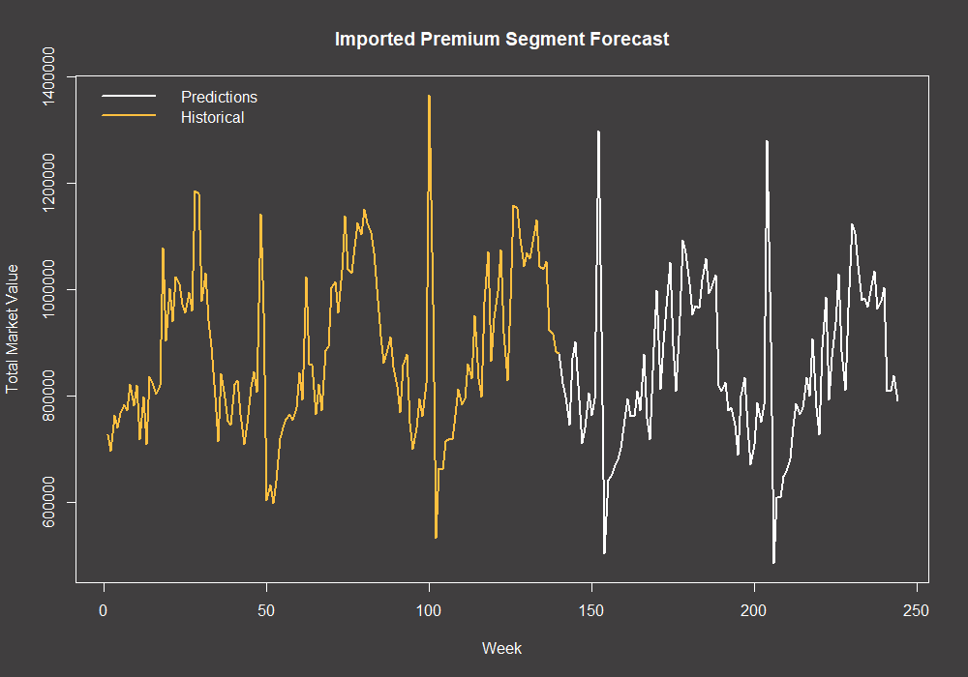
4.4-Beers into the Future
National
Zero Alcohol
Without Alcohol
Black
Extra
Flavoured
Imported Special
Imported Premium

Slide 22
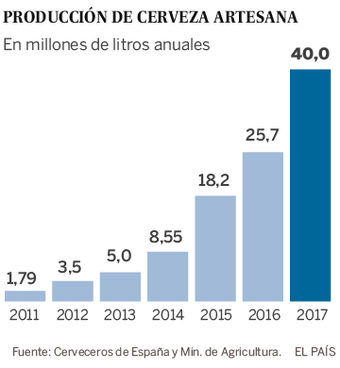
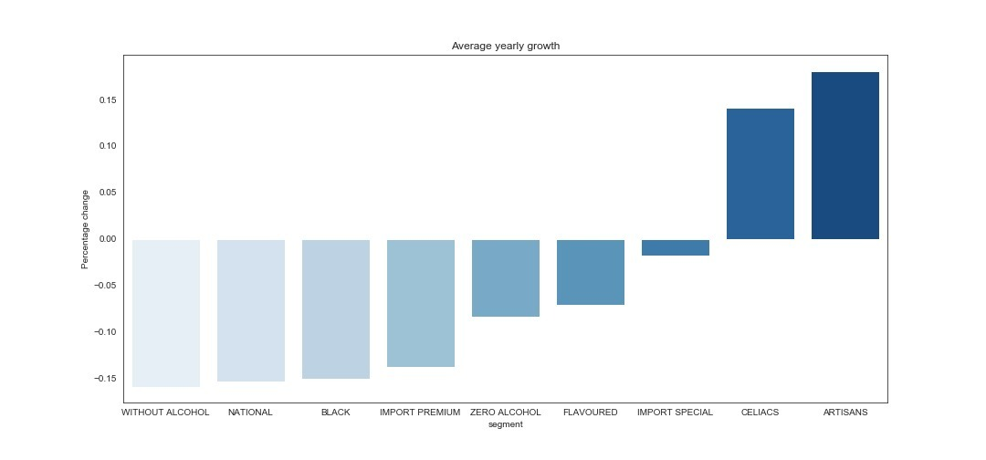
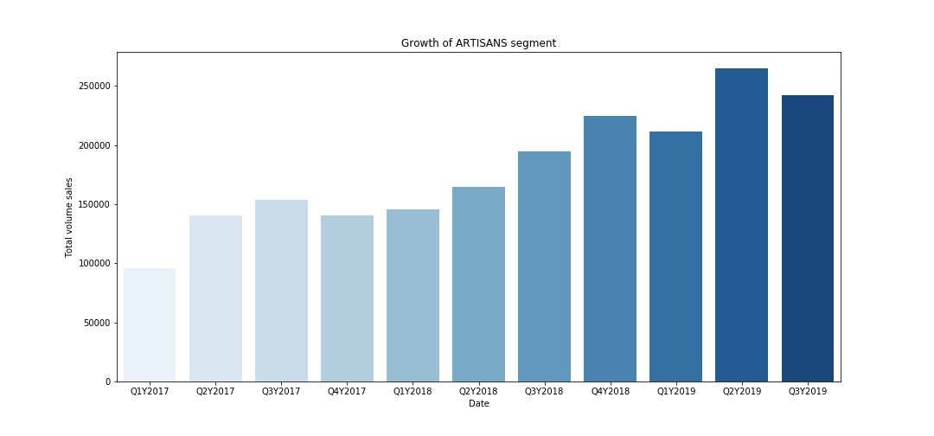
4.5-A New Hope
Hipsters to the rescue
Artisanal Beer is the growth market

Slide 23
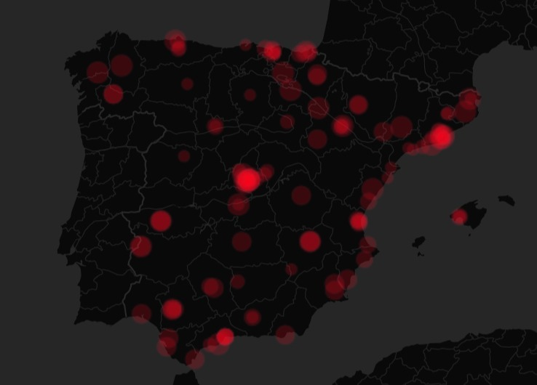
4.6- A New Hope
Artisanal beer is the answer
Growing
Opportunity
The artisanal market is currently growing at 37% per year in Spain
Our company currently has zero sales in this growth market
Proven success
New insurgents
In the US the craft beer market is worth over $114bn, 24% of total sales
Molson Coors has just arrived in the Spanish market, proving the opportunity

Slide 24
4.7- The Artisanal Solution
Seizing the opportunity
Targets
1% of the market by the end of month 1
5% of the market by the end of year 1
8% of the market by the end of year 2
-
This translates to €559,547 in revenue

Slide 25
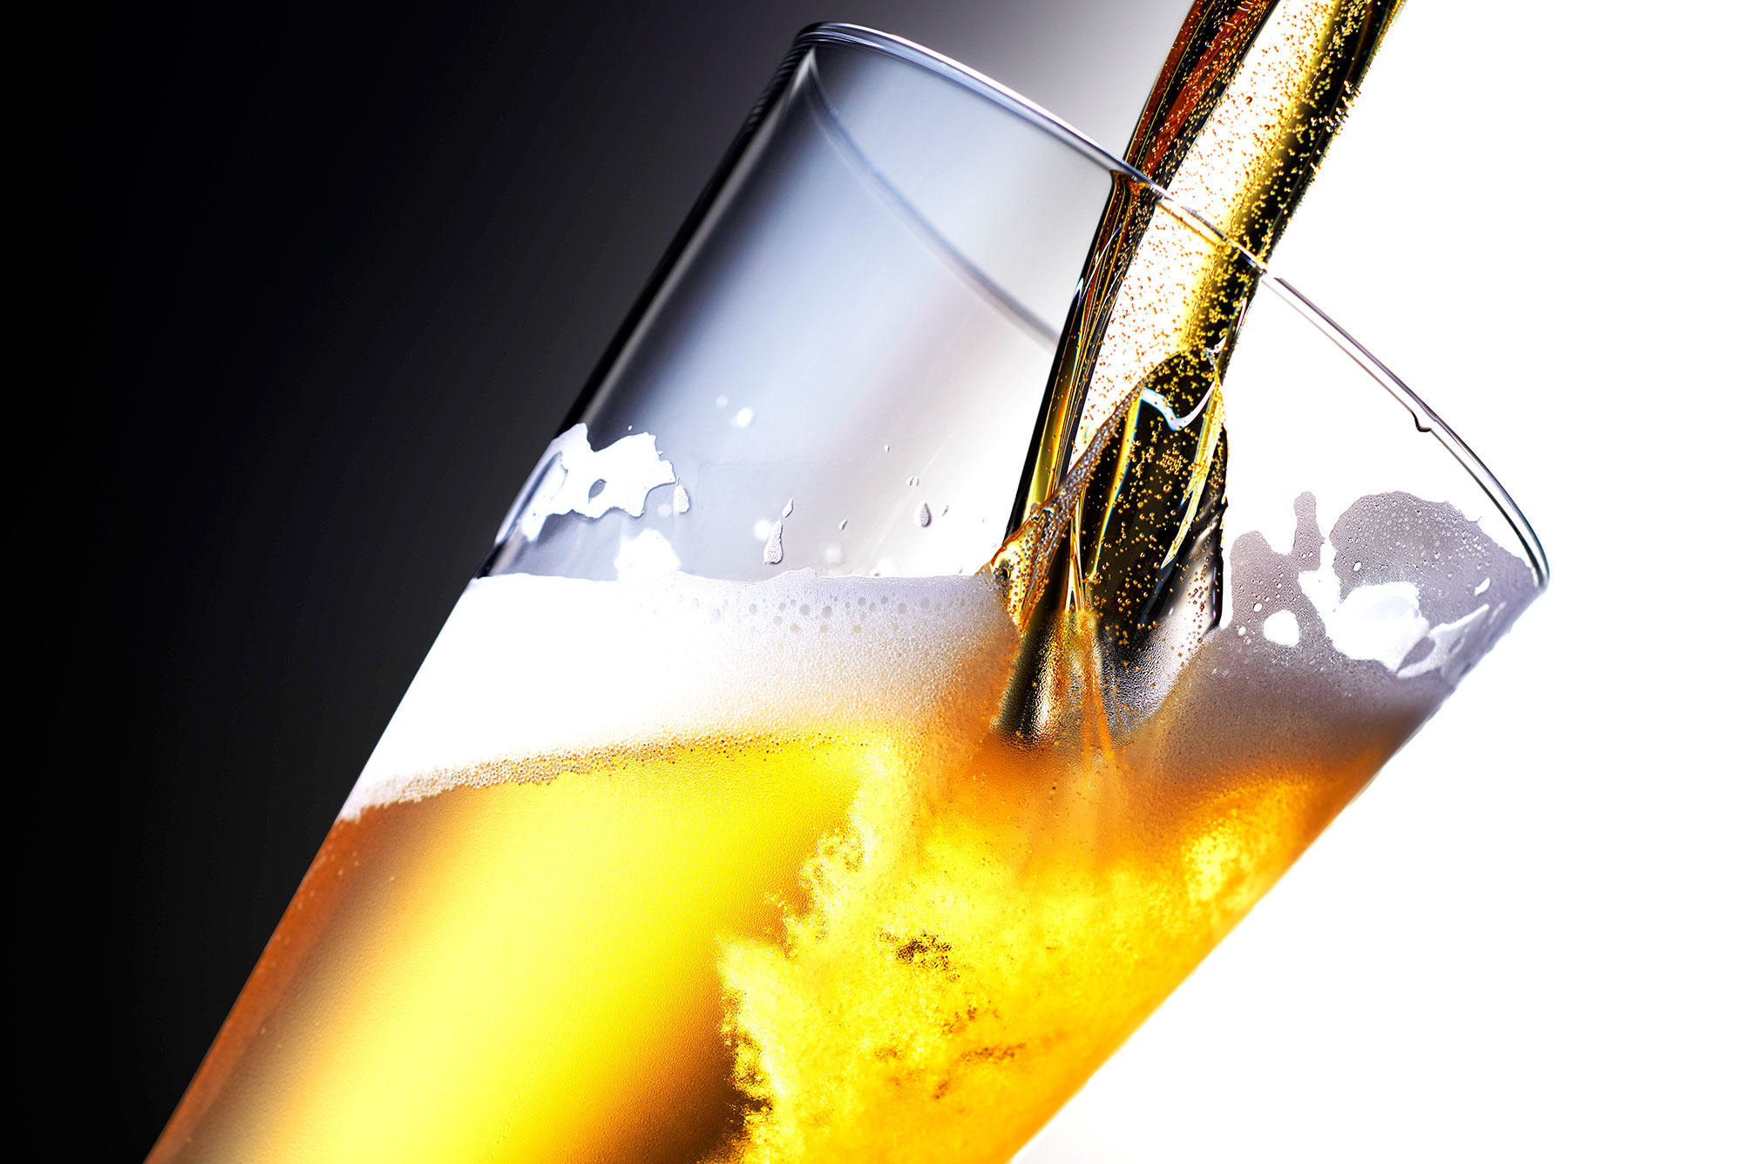
Any Questions?

